Slide 1
BLIP operations 4-6-10
Status – running at ~117MeV
  BLIP weekly average beam current constant at 102.5µA, with a peak of 109.7µA; values are the highest for the year. Operation with beam only 78.7hrs from March 28-April 4, due to BLIP vacuum window failure.
Operations issues
  While tuning for a low energy research irradiation on the morning of March 31 there was a sudden loss of beam line vacuum that automatically shuts beam.
  Access on Friday evening for inspection and dose survey showed that the second of two Be windows had fragmented. (See photograph.) The two windows are identical but the first one gets hotter due to electron stripping. It was installed in December of 2009 but the downstream window was installed in 2005. Therefore accumulated metal fatigue and radiation damage may be the cause of failure. However, there is clear evidence of water (?) drip onto area of window . Thermal shock cannot be ruled out as the cause of failure. This dripping has been detected before and a metal shroud is in place to cover the entire area. The source of moisture is unknown.
  After numerous well attended work planning sessions to discuss radiation and Be exposure issues, the repair was completed on Monday afternoon in only ~15 minutes. Personnel radiation exposure was minimal.

Slide 2
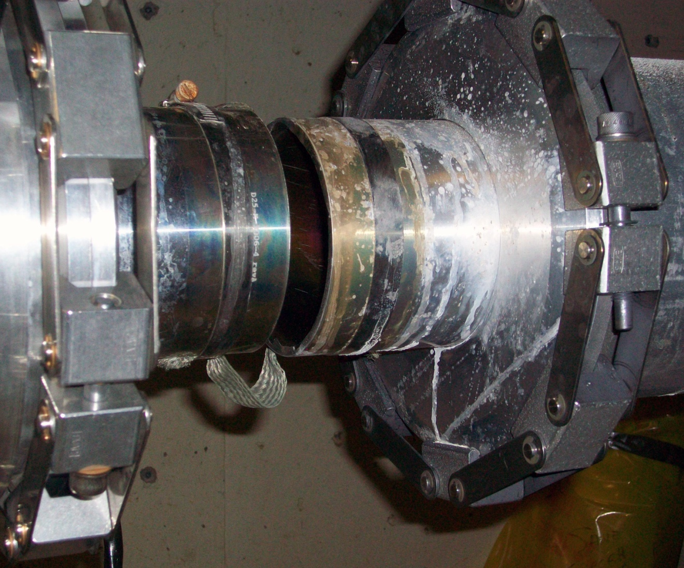
BLIP Be window assemblies

